Slide 1
State of Oklahoma Office of Management and Enterprise
Services (OMES)
SWC 200
State P-Card

Slide 2
Why P-Card rather than PO?
Saves agencies money
Quicker payment to the supplier
Rebate to agencies
Better transparency

Slide 3
The State of Oklahoma authorized P-Card is a Visa Purchasing Card issued by the Bank of America (BOA), corporate liability card
The P-Card is now an EMV or Chip & Pin card (PIN numbers mailed separately)- the chips are encrypted and create a unique transaction code that cannot be used again
Zero liability for unauthorized charges or for lost/stolen cards (Bank must be notified within 24 hours)

Slide 4
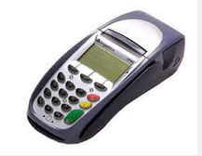
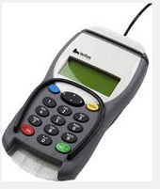
EMV card terminals
Transactions will be slowed down
with this new technology. They
stay in the machine during the
transaction and the machine will
prompt you for your PIN.
EMV terminal with side option for mag stripe
EMV terminal with top option for mag stripe
Mobile Square

Slide 5
Activating your card
When you receive your card there is a sticker across the
front with a phone number.
Call the number and key in your 16-digit card number
Provide the verification ID that has been provided to you
by your P-Card Administrator
Your purchases will be declined until your card has been
Activated!

Slide 6
PIN numbers
PIN numbers must be registered online at www.baml.com/PINCheck
If you forget your PIN you may retrieve it from this website
If you don’t have access to the internet, you can contact customer service to request a PIN reminder mailer. PINs cannot be provided over the phone.

Slide 7
Executive Steering Group
The agency decides who has a card, who the approvers are,
and appoints the
Administrator.
State Purchasing Director
State P-Card Administrator
Agency
P-Card Administrator
Agency
Approving Officials
Agency
Approving Officials
P-Cardholders
P-Cardholders
P-Cardholders
P-Cardholders
Notes:
Approving Officials are one level above the cardholder based on the agency’s organizational chart.

Slide 8
References
All purchases shall be made in accordance with State statutes, rules, and these Procedures, which include but may not be limited to:
Central Purchasing Act, 74 O.S. § 85.1 et seq.
State Travel Reimbursement Act (STRA), 74 O.S. § 500 et seq.
Central Purchasing Codified Rules, 260:115
State Purchase Card Procedures
Oklahoma State Travel Policy
Oklahoma Ethics Commission Rules
State Agency Internal Purchasing and P-Card Procedures
Other statutes pertaining to specific types of purchases

Slide 9
Exemptions
Agencies who are statutorily exempt from the Central
Purchase Act are NOT exempt from State Use. The State Use
statute is Title 74 O.S., Chapter 48 §3001-3010.
Higher education and political subdivisions are exempt from
the State Purchase Card procedures and may implement their
own procedures.

Slide 10
Encumbering Funds
Authority Order
AO should have sufficient encumbrance to cover all transactions prior to making the transaction (Encumbrance Law §62-34.62)
Change Orders to amend the encumbrance may be processed as necessary
A new AO should be issued each new fiscal year
Establish an Authority Order in PeopleSoft using:
Supplier ID - 0000001101
Supplier Location – 0002
PO Header Details – PO Type=AO/ITAO Origin=EXC
Item Number – 1000010910
Category Number – 84141602 (defaults in with Item Number)
Set Matching to “No Match” (No 11 on header)
Account Number – 601100
Mark as “Amount Only”, Optional Receiving

Slide 11
SAFEGUARDS
Agency appoints cardholders
Agency sets limits on each card
Approving official review
Agency determines disciplinary actions
Audit Division tracks fraud and misuse

Slide 12
Safeguards (cont’d)
Certain merchant category codes (MCCs) are also blocked by
the State of Oklahoma to help avoid inappropriate purchases.
These codes include recreation, entertainment, and other types
of purchases. Card profiles are set based on the types of
purchases will be making. The spend profiles are determined
by the individual agencies.

Slide 13
Employee Participation
All participants must read and sign the Purchase Card Employee Agreement.
If participant holds multiple roles, separate agreements must currently be completed for each role.
All P-Card participants must complete initial training conducted by OMES Central Purchasing Division;
Form F-1R or F-3R submitted annually, available on the Oklahoma Ethics Commission website (for cardholders making purchases of $50,000 or higher)
Refresher Training is required every 2 years, and is available on Skill Soft, through agency P-Card Administrators (if approved), or live class attendance (changing soon)

Slide 14
Using the Card
Purchases can only be made within your Single Transaction Limit and Credit Limit assigned to your card;
Cardholder is responsible for reconciling all transactions;
P-Card cannot be used to avoid or bypass appropriate purchasing or payment procedures;
P-Card is not for personal use
P-Cardholder shall ensure prices paid are
fair and reasonable

Slide 15
Using the card (cont’d)
No late fees or interest can be paid on an invoice (for
information on late fees and interest see the Statewide Accounting
manual)
Be sure and ask a potential supplier if they accept VISA,
not if they take a P-Card
Direct all of your P-Card questions to your agency P-Card
Administrator

Slide 16
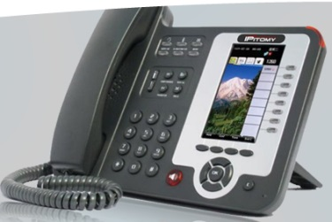
Methods of Purchase
Walk-in;
Telephone;
Internet
Make certain internet site is a secure location, for example:
“s” on the end of https means it is a secure site; or
Padlock will appear on the site
SW 690 – Road Oil
SW 670 – Aggregate
SW 081 – Asphalt

Slide 17
Return item to merchant in manner agreed upon
Credits- If the agency is credited for any items or services that were originally paid for with the purchase card, then the credit MUST be processed through the merchant system. The vendor should not be allowed to maintain a store credit or use the credit toward other invoices.
Merchant provides credit receipt documentation
Place with end of month transaction documentation for reconciling
Include with the payment at end of month
Credit may not appear until subsequent statement
Notes:
Refund checks, store credit, cash, are NOT acceptable forms of refunds. If the store won’t refund in the proper manner, you’ll need to seriously consider not using them in the future.

Slide 18
Prohibited Purchases
Split Purchasing;
Entertainment;
Per diem food;
Cash or cash advances;
Purchase of goods or services for personal use or not for official State use;
Any transaction or series of transactions exceeding your P-Card limits;
Motor fuel and automotive general maintenance;
Automatic Drafts (we do not want them to have the card # on file);
Gift Certificates

Slide 19
Request for Exception
A “Request for Exception” form can be completed requesting to make a purchase, even if the MCC is blocked.
Contact your agency P-Card Administrator with the pertinent details of your need.
Your P-Card Administrator will complete the request for exception form and send to our office. If approved, your Administrator will be notified and they in turn will notify you.
Your card will be moved into an exception profile for a short period of time to allow the transaction to be processed.

Slide 20
Convenience Fees vs. Surcharges
Convenience fee: a fee charged to the cardholder for the convenience of
paying online or by phone - the price of the product doesn’t change
Surcharge: a fee assessed by the merchant when using a credit card for
payment to recoup the merchant fees charged by the card processing company
Contact your agency P-Card Administrator first if a merchant insists on charging a fee.
Surcharges are prohibited in Oklahoma by, convenience fees are not prohibited. If a utility company utilizes a third-party processor for credit card payment
processing, this is a convenience fee (not prohibited per
OMES legal team)
To avoid convenience fees, agencies may opt to pay
companies charging these fees by PO.
If a company limits the amount of payment accepted
per transaction, you could incur more than one
convenience fee to pay the entire bill.

Slide 21
Convenience Fees vs. Surcharges (cont’d)
Title 14A O.S. §2-417 of the Oklahoma statutes states:
No seller in any sales transaction may impose a surcharge on a cardholder who elects to use a credit card or debit card in lieu of payment by cash, check, or similar means.
As used in this section, “debit card” means any instrument or device, whether known as a debit card or by any other name, issued with or without fee by an issuer for the use of the cardholder in depositing, obtaining or transferring fund from consumer banking electronic facility.
For purposed of this section, a private educational institution as defined in paragraph (e) of section 3102 of Title 70 of the Oklahoma Statutes may charge a convenience fee. The convenience fee shall be limited to bank processing fees and financial transaction fees, the cost of providing for secure transaction portal fees, and fees necessary to compensate for increased bandwidth incurred as a result of providing for an online transaction.
While convenience fees are allowable, Okla. Stat. tit. 14A. §2-11 holds that the seller has to be registered with the United States Treasury Department as a money transmitter pursuant to 31 CFR, §103.41. You are usually going to see these with an entity providing an electronic funds transmission service, including service by telephone and the internet (Ex: I pay my cable bill over the phone. My bill doesn’t change. I’m paying a convenience fee for not mailing anything, etc. and doing it over the phone while I’m still in my pajamas.)

Slide 22
Card Limits
There is no limit on the amount of a P-Card
transaction for the following:
Statewide Contract purchases
Utilities (water, electric, gas, sewage)
Interagency Payments
Professional Services as defined in 18 O.S. § 803
For any other transaction with a state purchase card, the transaction shall not exceed $5,000.00

Slide 23
Interagency Payments
Interagency is defined according to 74 O.S. § 1003 (Inter-local Cooperation Act) and includes, but not limited to:
Political subdivisions
Federal Government
Public Trusts
Interagency payments between State Agencies, Universities, and Colleges:
Should be made by voucher, selecting the payment method “WIR”
DCAR Newsletter, Vol. 21, No. 7, dated February 18, 2011 (page 3)
Agencies can choose to accept P-Card payments from other agencies.

Slide 24
**IT & Telecom Purchases**
IF your agency has set up an IT AO, the following IT purchases may be made with the P-Card:
Transactions up to $5000 if items are listed on the published hardware/software list;
Transactions up to $15,000 if items are listed on the published hardware/software list AND items are purchased from a statewide contract supplier **NEW
See ISD Procurement Policies and the IT and Telecom ePro requisition procedures for guidance.
See PIM 06302015 and P-Card procedures section section 6.7

Slide 25
Contact Information for IT questions
OMES Service Desk
405-521-2444
servicedesk@omes.ok.gov

Slide 26
At the time of need, check……
#1 State Use Contract (if not selected obtain an exemption from State Use prior to purchase)
#2 OCI (if not selected obtain an exemption from OCI prior to purchase)
#3 Statewide Mandatory Contract
(if not selected obtain an exemption from Central Purchasing prior to
purchase)
#4 Statewide Non-Mandatory Contract
#5 Open market- best price

Slide 27
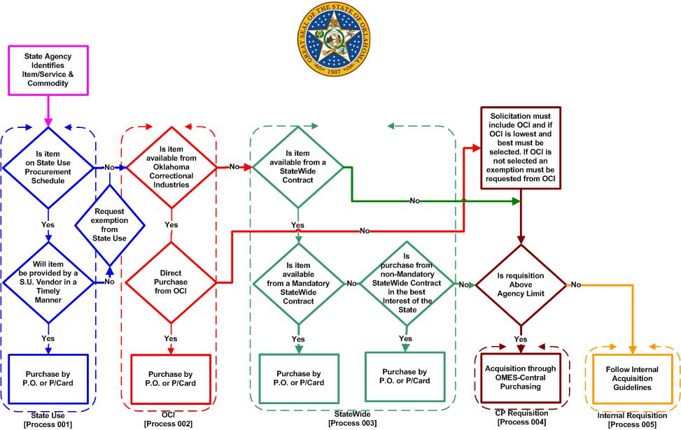
Central Purchasing Procurement Flow

Slide 28
State Use
Utilizing Talents
Satisfying Needs
Empowering Individuals
Oklahoma Statute Title 74, Chapter 48, Sections 3001-3010

Slide 29
What is State Use?
Set-aside program established in 1974 to provide employment opportunities to persons with severe disabilities.
Operated through qualified, nonprofit organizations that supply products and services to the state.

Slide 30
State Use Procurement Schedule
First source when searching for goods and services.
All registered vendors in the State Use Program listed.
All products and services provided by State Use vendors listed.
Statewide contract number and price.
Remaining items (suitable to procure list) – state use vendors must be included in any bid or quote.

Slide 31
Contact Us
Daron Hoggatt – State Use Administrator
405-521-4474
Cell 405-568-6108
Daron.Hoggatt@omes.ok.gov
Teresa Sherwood– Administrative Assistant
405-522-3367
Teresa.Sherwood@omes.ok.gov
Mary Brown – Procurement Officer
405-521-2128
Mary.Brown@omes.ok.gov
Amanda Wagaman – State Use Liaison
Cell 405-626-0973
Amanda.Wagaman@omes.ok.gov

Slide 32
Searching Statewide Contracts
www.omes.ok.gov -> Central Purchasing -> Stateside Contracts
(Lisa Bradley - demo how to search through the contracts on the website)

Slide 33
Road and Highway Contracts
Card Security
P-Card is limited to person whose name is on the card;
Do not loan your card;
Do not use another person’s card;
If possible, file card in a secure, locked place when not in use;
Immediately report any lost, stolen or compromised cards to BOA at (888) 449-2273; Entity is responsible for purchases on lost, stolen or compromised P-Cards until BOA is notified

Slide 34
What happens if I am gone for a period of time from work?
The P-card Admin. can put your card in “suspense” $0.00 while you are away.
You should leave your card locked up at the office.
Your cardholder statement must still be signed and turned in at the end of the month.
P-card holder is responsible for making sure this is done.

Slide 35
How does fraud happen?
How do I know it’s happened to my card?
What do I do about it?
How long does card replacement take?
Fraud vs. Misuse (violation of procedures/policies for personal gain)
Fraud vs. Abuse (violation of procedures/policies for work-related gain)

Slide 36
When fraud happens, Bank of America will send an
email to the cardholder IF there is an email address
listed in Works.
The agency P-Card Administrator may receive a phone call.
The bank will confirm which transactions are allowed to
be paid vs. those that they will reject.
The bank will close the card and reissue a new card

Slide 37
All transactions are subject to audit by
State Auditor and Inspector
Central Purchasing Division
OMES- Comptrollers Office
Detailed transaction documentation supporting P-Card transactions shall be retained by the State Entity and made available upon request
OMES Audit Division has installed new monitoring software that will digitally touch each P-card transaction and perform multiple tests on each one.

Slide 38
What does the auditor look for?
All invoices signed and dated
Packing slips signed by the receiving employee for items shipped
Asset numbers for items over the inventory thresholds
Cross-referenced credits to original purchase (list TXN of credit transactions on original purchase)
Training is current
You are aware of your internal policies and procedures

Slide 39
What does the auditor look for? (cont’d)
Approvers are one level above cardholder base on the agency’s organizational chart
Employees listed in Works as Scoped Administrator can actually sign into Works
Multiple transactions to the same supplier in a short period of time totaling more than $5000 to a non-contract supplier
They will ask for:
Signed/dated employee agreements (you should have a copy)
Internal purchasing and P-Card procedures
Copies of exceptions granted during the audit period

Slide 40
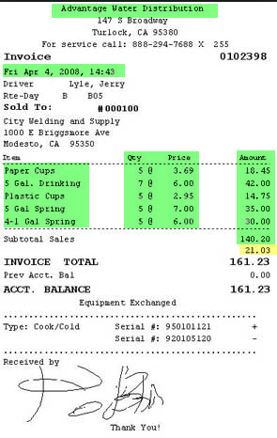
Receipts
Itemized Receipt must be obtained for all purchases
Name of merchant
Date of Purchase
Description
Unit price and quantity
Transaction total
Sign each receipt and include with Statement at end of cycle

Slide 41
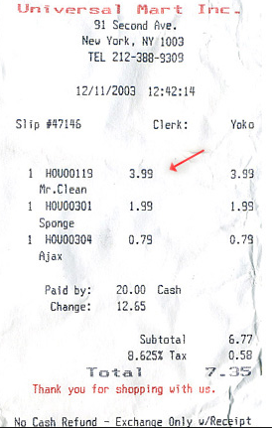
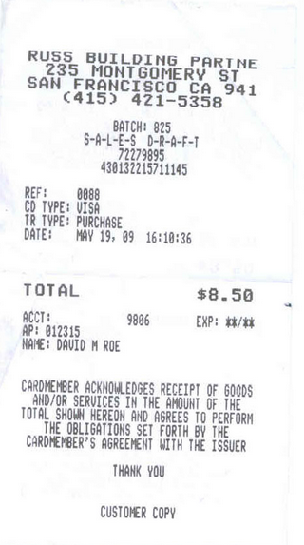
Valid? Or not valid?
Merchant name
Date
Description
Quantity
Item price
Extended price
Total amount
Even though there
is tax charged (which of
course the cardholder
would notice and have
credited before leaving
the store) it has all the
required information.

Slide 42
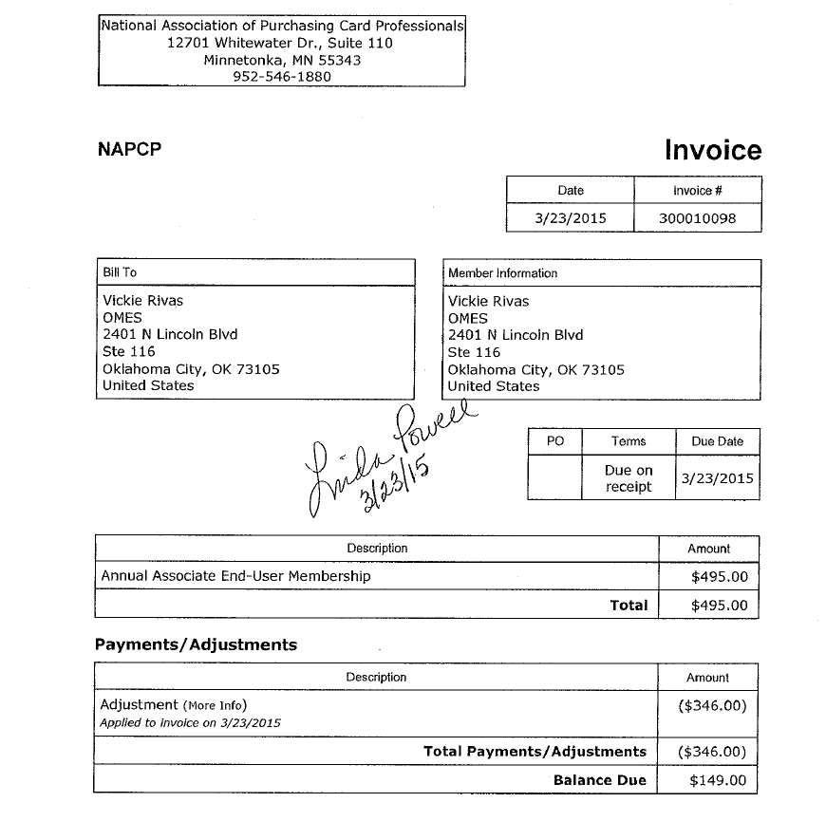
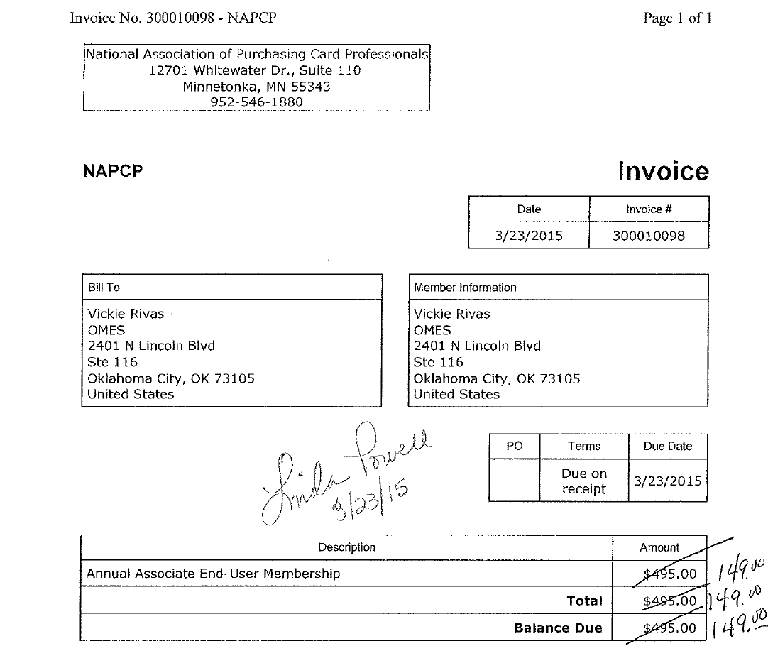
Unacceptable
Acceptable

Slide 43
Multiple Receipts
Multiple Receipts Provided- If the merchant provides two receipts – one with the total amount and one itemized - the P-Card holder shall attach the itemized receipt to the total amount receipt.
The receipt shall be retained by the P-Card holder for the monthly reconciliation process.
See Section 6.9.4 of the P-Card Procedures for guidance related to unobtainable receipts.
Note: P-Card holder may contact the Issuing Bank’s Customer Service at the phone number listed in Appendix A, to obtain a missing or lost receipt at the cardholder’s expense. The charge will appear on the next statement as a bank fee (there will not be a receipt for this fee and the cardholder may be required to reimburse the cost to the agency).
Notes:
Contacting the bank for a missing receipt is absolutely the last resort and should never be done if at all possible.

Slide 44
Receiving Goods and Services
Goods or services received at the time of purchase- The receipt for purchase shall serve as the receiving document. The receipt must contain the P-Card holder’s signature and date. A carbon copy of the receipt containing the P-Cardholder signature and date meets this requirement.
All remaining Transactions- The receiving employee should sign the packing slip and provide to the cardholder.
The cardholder’s and approving official’s authorization on the cardholder’s statement indicates that these products and services were received and approved to be paid with the purchase card.

Slide 45
Payment Confirmation
Payment Confirmation- A payment confirmation must be obtained for internet or payment over the phone purchases. The payment confirmation can be part of the receipt or accompanying the receipt. When the purchase card is used to pay for an invoice, then the supporting documentation must be accompanied by a payment confirmation or the payment confirmation number must be written on the invoice.

Slide 46
Open Books
All transactions are listed on the State of Oklahoma Open Books website, listing
Cardholder’s last name, first initial
Merchant Name
Amount of transaction

Slide 47
Construction & Properties (CAP)
Is there a maximum dollar project amount where an agency is not required to go through CAP to enter into a contract and pay by P-Card?
Yes, public construction contracts for less than Five Thousand Dollars ($5,000.00) for minor maintenance or minor repair work may be negotiated with a qualified contractor by the agency. However, no work shall be started until a written contract is executed and proof of insurance has been provided by the contractor to the awarding public agency. DCAM/CAP – Form M601 Contract for Minor Construction Work is available for use.
Questions? call 521-2112

Slide 48
Agency Assets
Each agency has an Asset or Inventory Manager
Please check with them for the specifics of your agency
for reporting
52 agencies currently utilize the asset management module
in People Soft – for those that do, the following information
is required to be entered into the Works transaction:

Slide 49
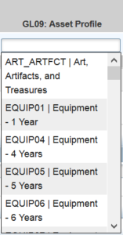
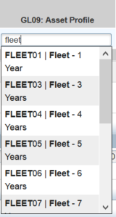
Non-IT Assets
Asset account codes begin with 541 (refer to the Statewide Accounting
Manual Appendix 4)
For assets costing less than $25,000 use a profile ending in 01
in the GL09 field.
For assets costing $25,000 or more use a profile ending in 05
or higher in the GL09 field.
Reporting threshold for non-IT assets is $2,500.00

Slide 50
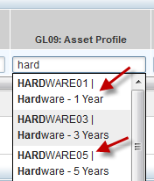
IT Assets
IT asset account numbers are: 541120 (hardware), 541130 (software) and 541230 (telecom
equipment). CORRECT CODING IS VERY IMPORTANT.
For assets costing less than $25,000 use HARDWARE01 or
SOFTWARE01 in the GL09 field.
For assets costing $25,000 or more use HARDWARE05 OR
SOFTWARE05 in the GL09 field.
Reporting threshold for IT assets is $500.00
An accurate description of the item purchased such as software, laptop, network switch,
etc., will help ISD keep track of reportable assets if the GL09 field is left blank.

Slide 51
Registration Payments
P-Card purchases are subject to the Statewide Accounting Manual, Chapter 50.10.06, Section J Advance (Pre-) Payments
Can use P-Card for advance conference registration when:
Discount is provided for paying in advance;
Can substitute a participant;
If event is canceled, cardholder receives a full refund
Registration fees for conferences, meetings, seminars, and similar events whereby in special situations an organization requires pre-registration along with payment and by standard policy will not accept a state purchase order/contract in lieu of payment, documentation on the vendor's stationary describing this fact must be sent together with the claim to OMES for consideration and approval or disapproval.

Slide 52
Cardholder
Responsibilities
Some responsibilities of the cardholder are:
Make sure to purchase from the correct supplier
Know your card limits
Know who your agency P-Card Administrator is
Keep your card secure
Make sure your purchases in Oklahoma are not charged tax
Editing transactions at least weekly if editing is required by your agency
Reading the P-Card Procedures and any updates that are received
Making sure itemized invoices are received and included with the end
of cycle statement and send to Approving Official/back-up Approving
Official

Slide 53
Approving Official
Responsibilities
Approving Official reviews Cardholder’s reconciled statement and transaction documentation for:
Accuracy;
Completeness;
Appropriateness of the purchase;
Verifying transactions were conducted according to Statutes, Rules and Procedures
To indicate concurrence and that all required documentation is included, Approving Official shall sign and date the statement and forward the statement and documentation to Entity P-Card Administrator

Slide 54
P-Card Administrator Responsibilities
State Entity P-Card Administrator is responsible for performance of, or appropriate delegation of the following duties:
Processing and retaining P-Card Program Reports:
Monthly Invoice
Monthly cardholder statements
Other reports are available in Works and we urge P-Card Administrators to utilize these as well
Scheduling and monitoring participant training
Processing and retaining P-Card Employee Agreements
Establishing written agency P-Card program policies and procedures
Order new cards and deactivate cards
Notes:
It is the P-Card Administrator’s responsibility to make sure that all cardholders, approving officials, and themselves are trained every 2 years either through Skill Soft, the OMES class, or approved agency training. For questions, email the State P-Card Administrator.

Slide 55
P-Card Administrator Responsibilities
Establishing and maintaining usage controls and determining cardholder’s need for the P-Card
Auditing of reports and transactions to identify unauthorized use
Auditing a random selection of cardholder’s monthly statements for accuracy
Setting Lodging or Travel Only P-Cards in “Suspense” status in Works with Credit Limits at $0.00 when not in use
Establish procedures for maintaining necessary data before it is removed from Works
Paper Copies
Electronic Copies, must meet:
OMES Information Security Policies, Procedures and Guidelines
Oklahoma Archive Commission Rules

Slide 56
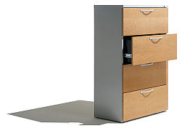
Records Retention
Records include any transaction documentation, such as, statements, receipts, disputes, correspondence, etc.;
Includes documentation in paper or electronic form and must meet:
OMES Information Security Policies, Procedures & Guidelines
Oklahoma Archive Commission Rules
Must be maintained for seven (7) years;
If audit occurs, the records are required to be retained for two (2) years after issues are resolved or until the end of the seven (7) year period, whichever is longer
If litigation occurs, records must be kept indefinitely

Slide 57
Maintenance
Changing the Entity’s P-Card Administrator or Back-up:
Submit a request on entity letterhead, signed by the Entity’s Chief Administrative Officer, to the State P-Card Administrator via email or fax advising of the changes
Submit OMES-FORM-CP-034 to State P-Card Office
Please do so in a timely manner so we can get this updated.
Why do we keep a list? We want to know who to contact if we have an announcement or issue. We let the bank know who the P-Card Administrator and Back-up are for security reasons.

Slide 58
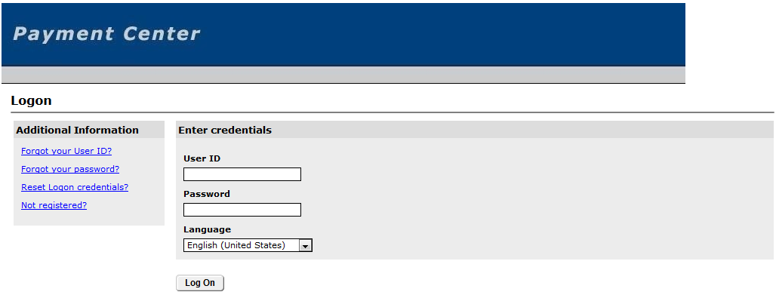
Payment Center
Official VISA Site
Access from Works Home page
P-Card Administrators Only
Print Company Statement
Compare to Works Totals
File with Monthly P-Card Records

Slide 59
Disputes may be reported by the Entity P-Card
Administrator to BOA who will assist the State in resolving
the dispute;
Must be initiated within 30 days of the purchase date;
Always try to resolve with the merchant first prior to
contacting the bank if possible;
Disputed amount will be paid at the end of the month and
a credit will appear in a subsequent statement.
Notes:
All attempts for resolution with the merchant should be exhausted before a formal dispute to the bank.

Slide 60
Travel Purchases – P-Card
Except for airfare, lodging, taxi, shuttle, parking, & rental car all other travel-related expenses are prohibited on the P-Card, such as:
Meals, including room service
Hotel Telephone (not business related)
Internet (not business related)
Traveler must pay out of pocket for all other travel related expenses
Travel Claim may be submitted by the Traveler for reimbursement of travel related purchases prohibited on the
P-Card (OMES Reimbursement Form 19)

Slide 61
Airfare and Lodging are considered separate transactions ($5,000.00 limit on each)
Travel can be purchased for:
Active State Employees or Officials of the State
Non-State Employees (as allowed by STRA) when
Performing substantial and necessary services to the State and
Directed or approved by appropriate department official
Must follow the STRA statutes and OMES State Travel Procedures
OMES may audit travel documentation (100% audited at this time)
Non-compliance may result in loss of P-Card travel privileges and/or additional travel training being required
Travel for contractors and/or their agents cannot be booked with the P-Card

Slide 62
Notes:
Title 74-500.9 now allows the OMES Director to approve an in-state lodging stay up to 150% of the current standard rate if it is determined that no lodging is available at the current maximum rate. Request for exception (OMES Form 035) must be approved prior to booking the lodging.
Traveler Information required to be entered in
Works for travel transactions is listed in the State
Purchase Card Procedures, section 6.13.1.2.2.

Slide 63
Reservations may be made by:
Agency Travel Coordinator
Card is in Travel Coordinator’s name
Must complete Lodging Letter and send to hotel
Traveler
Card is in the Traveler’s name

Slide 64
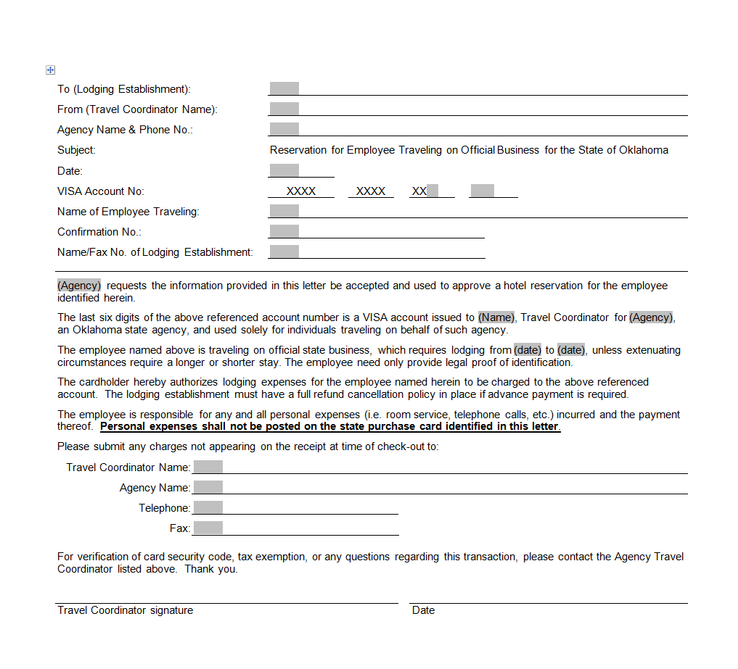
Lodging Letter
Be sure and add the Tax ID number on
this letter for
in-state lodging.
Notes:
For in-state lodging we recommend that you add the State’s Tax exempt # to this letter.

Slide 65
State of Oklahoma is exempt from Oklahoma State Sales Tax
State Entities also have immunity from taxes imposed by Oklahoma municipalities, which includes, but not limited to:
City Sales tax;
Occupancy tax;
Tourism tax;
See DCAR Newsletter Vol 20, No. 6, dated 03/11/2010 regarding immunity from local taxes
The State of Oklahoma is not exempt from Tribal Tax.

Slide 66
Travel no-shows
If an employee is signed up to attend a Conference, stay at a hotel, or has scheduled a flight and does not show up for the event it is up to the employee to pay back the money to the agency.
Please check with your agency’s internal purchasing procedures.

Slide 67
Important!
The State makes one combined payment to the bank each month
Late payment or non-payment of P-Card purchases will result in State Entity’s P-Cards being frozen or canceled, and may include additional action to obtain the payment and/or interest accrued
There is information on our website about the program, training offered, and deadline schedule

Slide 68
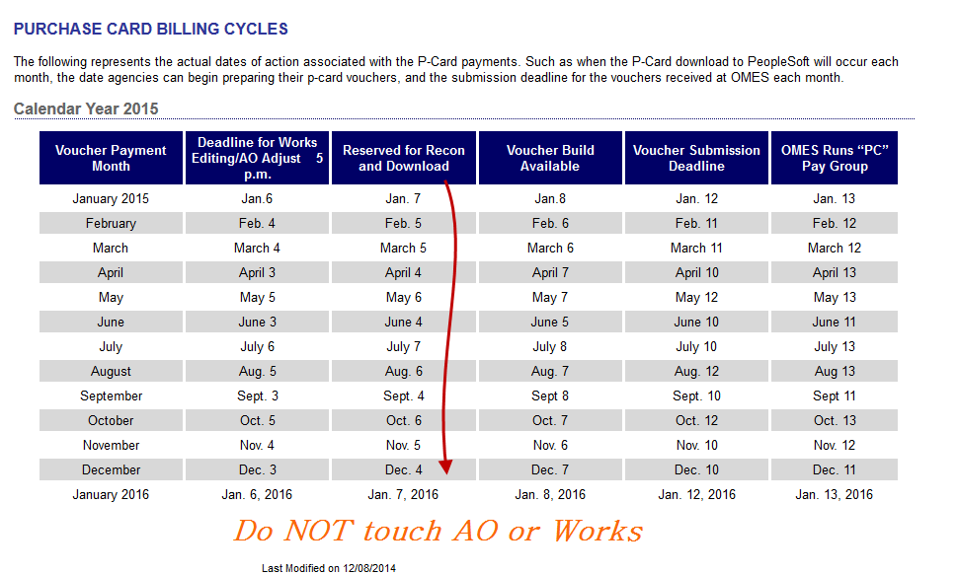

Slide 69
End of cycle deadlines
Deadline schedule on website is the final editing deadline for completion of all changes to Works transactions, which means that all transactions are to be CLOSED by the posted deadline.
Agencies should set internal deadlines in order to meet the posted deadline.
This includes clearing all flagged transactions.
This also means that all Authority Orders (AOs) must be approved and dispatched.
The State P-Card Office must be advised of any emergency AO revisions that may conflict with the posted schedule.

Slide 70
**NEW**
Central P-Card Office email
pcard@omes.ok.gov

Slide 71
BOA- Works
WORKS
https://payment2.works.com/works/

Slide 72
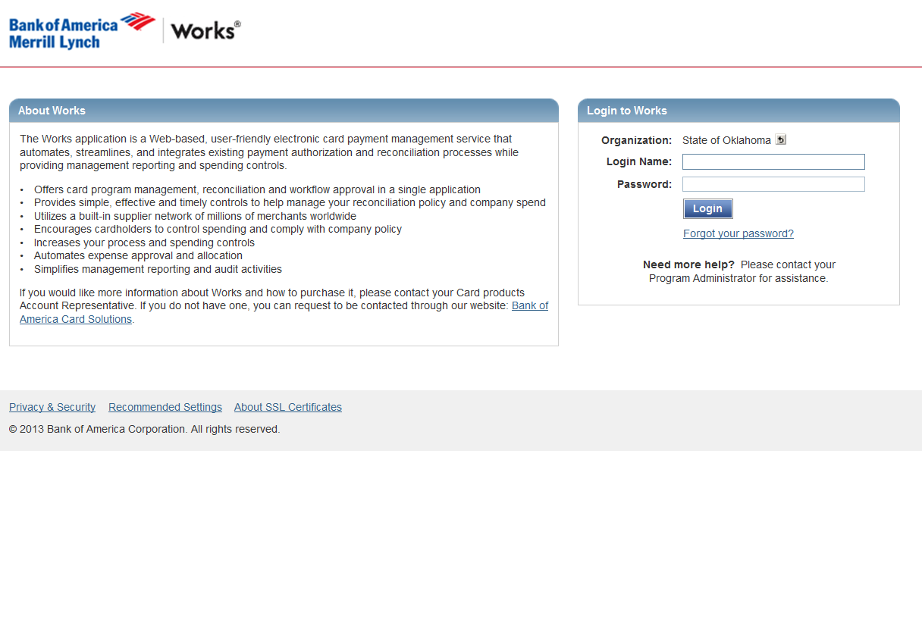
Login Page
If you currently have access to the old system, your old password and login will be used for this site as well.

Slide 73
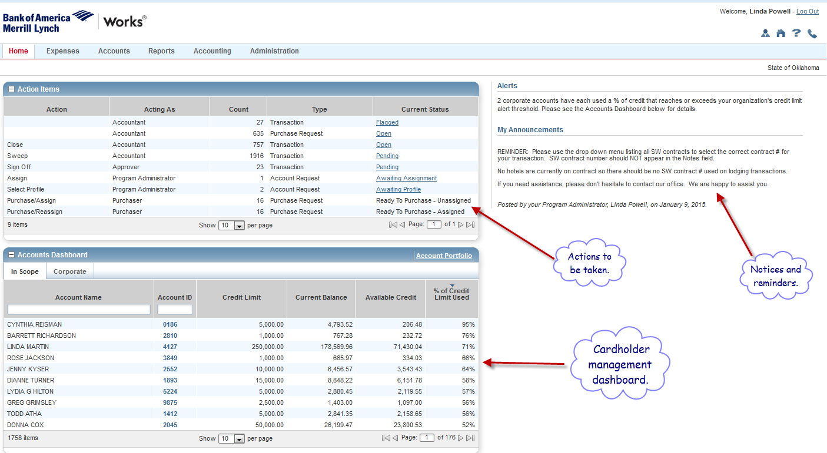
Home Page

Slide 74
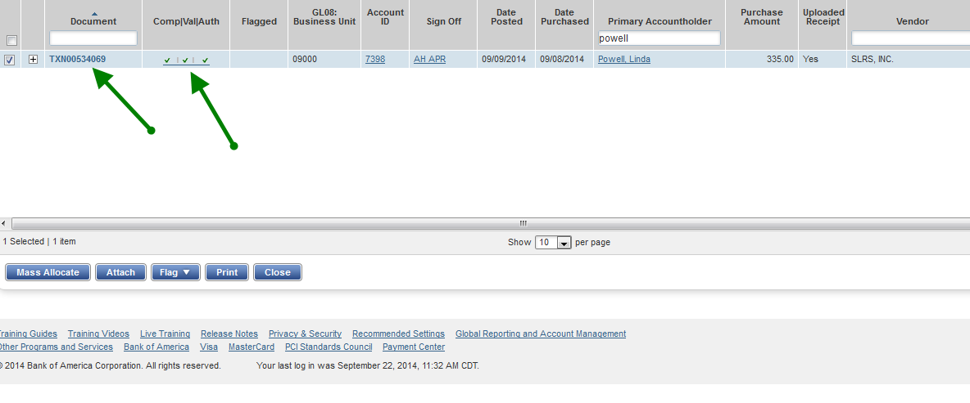
This option
requires you to
select the add/edit
screen from a drop down
menu.
This option takes you directly to the add/edit screen.

Slide 75
Add/edit Screen
TXN # for cross referencing
Sample of Dept ID with program code
Sample of Operating Unit with Chartfield2

Slide 76
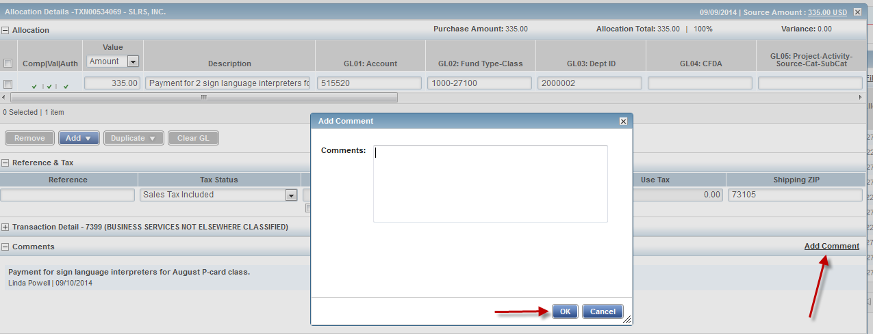
Comments

Slide 77
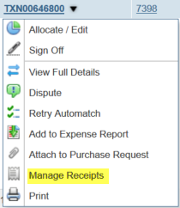
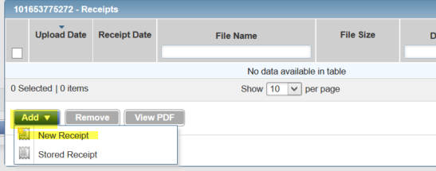
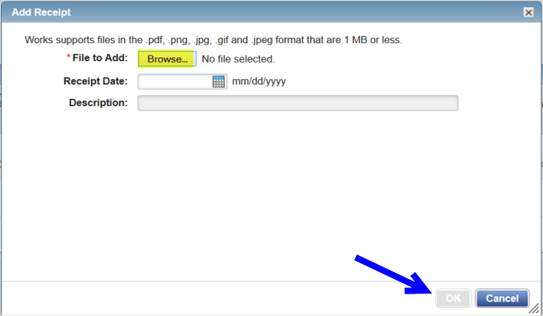
Adding Receipt/Invoice
To attach an invoice or receipt to a transaction, scan the document to a file. Select manage receipts, click add-new receipt and then browse for the document.

Slide 78
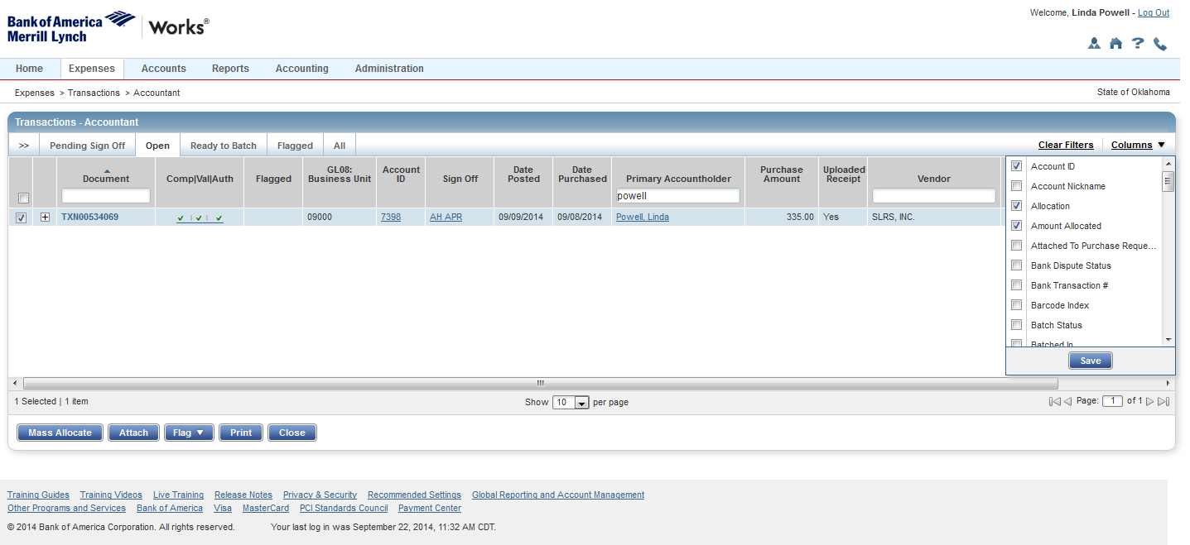
Adding or deleting columns
To add or remove columns to view, click on columns drop down list and select or unselect
columns. Once saved you can change the order of the columns by clicking in the column
header area and dragging it to the new location.

Slide 79
Editing Transactions
All transactions must be coded with the correct GL information in Works for downloading to PeopleSoft;
Can be performed by the Cardholder, Manager, or Accountant;
Account codes may default into the transaction, but must be verified they are correct.
Must complete at a minimum:
Account Code (GL:01)
Fund Type-Class (GL:02)
Dept. ID-Program Code (GL:03)
Business Unit (GL:08)
PO# and Lines (GL:10)
Notes:
3 red x’s here means lots of information is missing. To prevent this from happening, most if not all of this information can be defaulted into Works by the Agency P-Card Administrator.

Slide 80
NEW Program Codes
As of July 1, 2015 the Dept. ID-Program code field became a
13-digit field. All FY16 AND FY 15 transactions require the
5-digit program code.
The Governor identified 5 major programs and all purchases are related to either one of these programs or are unrelated to any specific program in which case the program code will be NP000.
Examples: 1010000-A0200 or 1020000-NP000

Slide 81
GL06: Operating Unit Field
This field also changed effective July 1, 2015.
All agencies (if using the Operating Unit field) will
see –N/A at the end.
Example: 7215000-N/A
Only the Department of Education will see an actual value
following the Operating Unit.
Example: 0015000-391

Slide 82
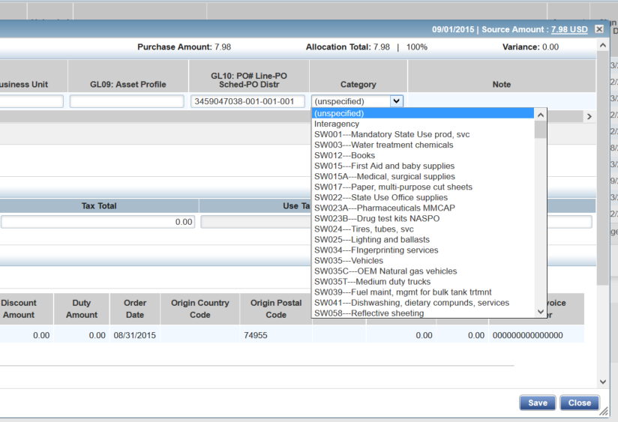
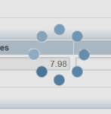
Statewide Contract Number
The statewide contract # must be selected from this drop down menu
so it will appear in the correct location on reports and statements.
You must click on Save after making any changes to the transaction. You should
see a circle of dots moving. If you don’t see this and you click Close here,
nothing will be saved. Click the Save button again if necessary to get the circle.
If purchase is from a SW contract supplier, you must select the contract # from the drop down menu shown here

Slide 83
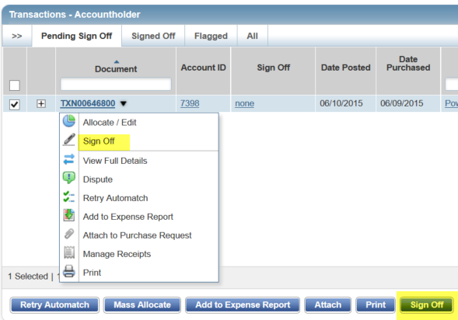
Signing Off
Once edits are saved, the transaction must be signed off to proceed to the next queue
You can sign off a transaction by checking the
box to the left of the transaction and clicking
the blue sign off button, this will also allow you
to sign off multiple transactions at one time, OR
click on the TXN number and selecting sign off
from the list.

Slide 84
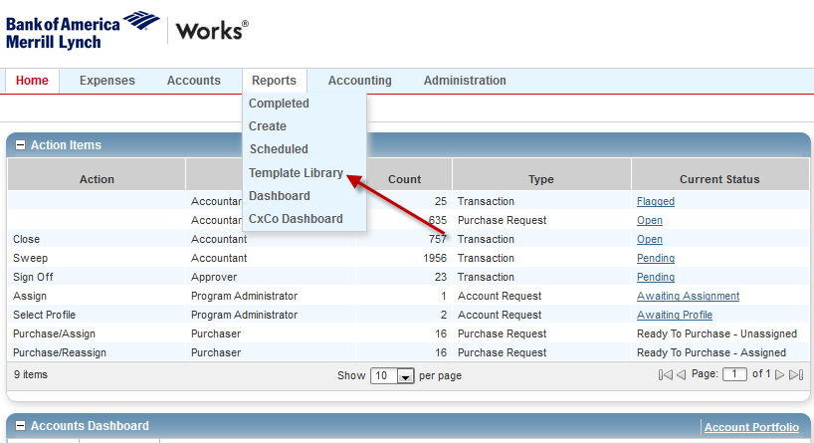
Cardholder Statement
At the end of each cycle you will need to run your P-card Statement. Please follow the steps below to run your report.
Click on Reports and select Template Library

Slide 85
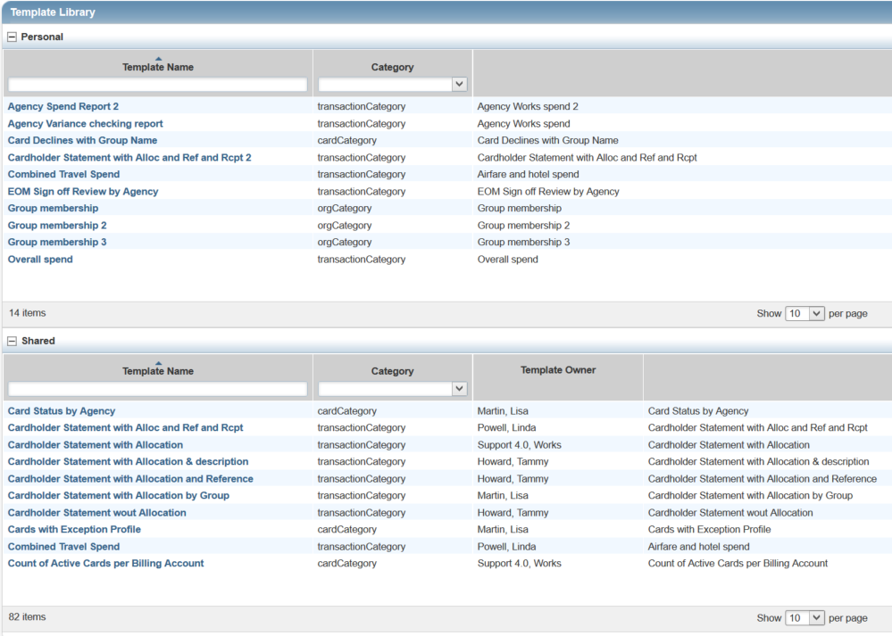
Choose the cardholder statement required by your agency and click on Modify/Run.
You will need to check with your P-Card Administrator to see which cardholder statement your agency prefers you to use.
Click on the name of the statement and the following screen will come up.

Slide 86
Scrolling down
Choose your card and verify the cycle date
The previous cycle dates are defaulted for this report, but you may verify by clicking on the calendar icon.
Click on the magnifying glass to the right of Card.

Slide 87
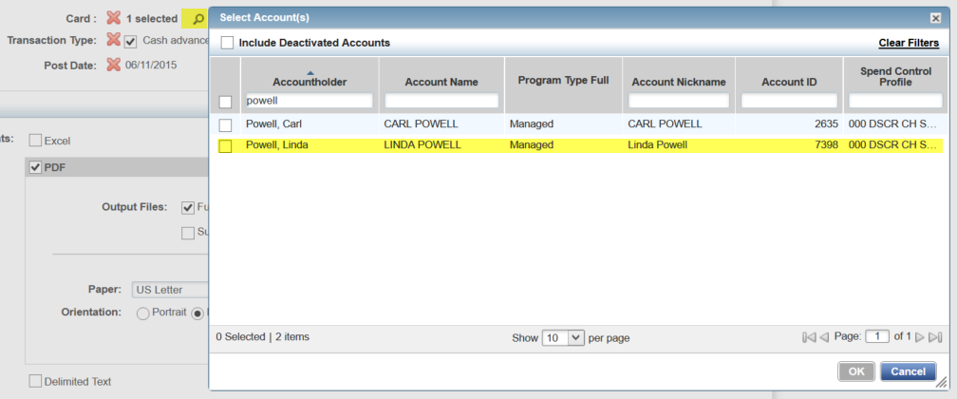
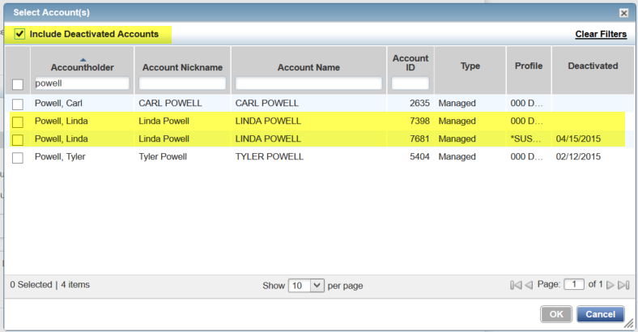
If needing to pull into a statement transactions from more than one card in a single cycle due to card
compromise or loss, click on the box in the top left corner to Include Deactivated Accounts. Then select
all cards for that cardholder by clicking on the boxes to the left of the name.

Slide 88
Submitting Report

Slide 89
Ready to view my report
Once you select Submit Report, you will be taken to the
Completed Reports section. Click on the underlined blue
Output Type to open the document.
Click to view report

Slide 90
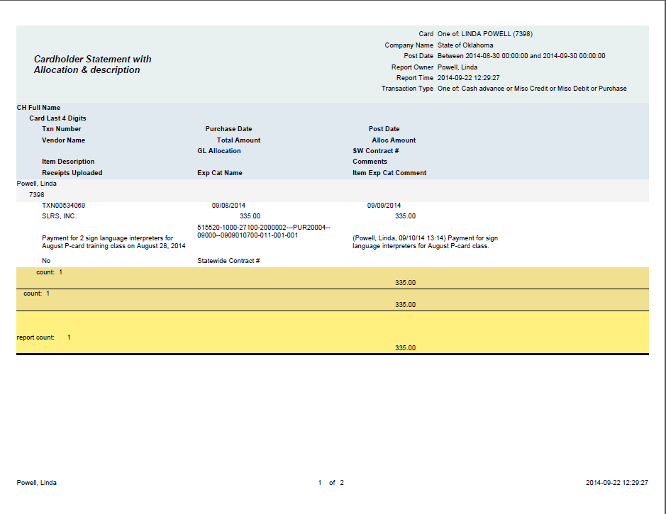

Slide 91
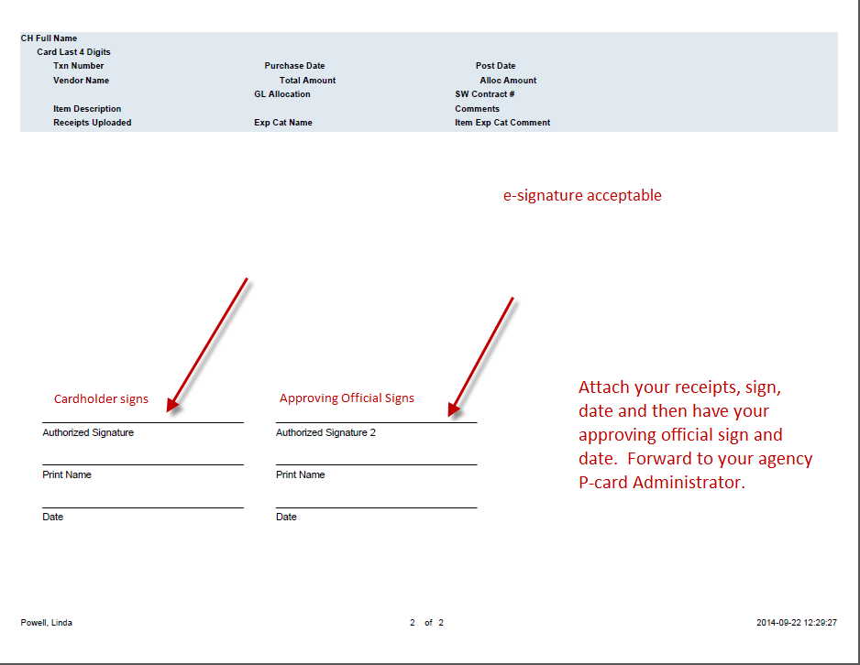

Slide 92
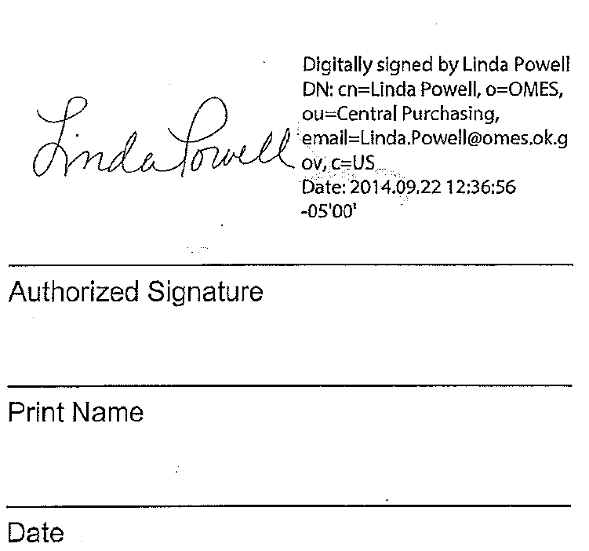
What is an electronic signature?

Slide 93
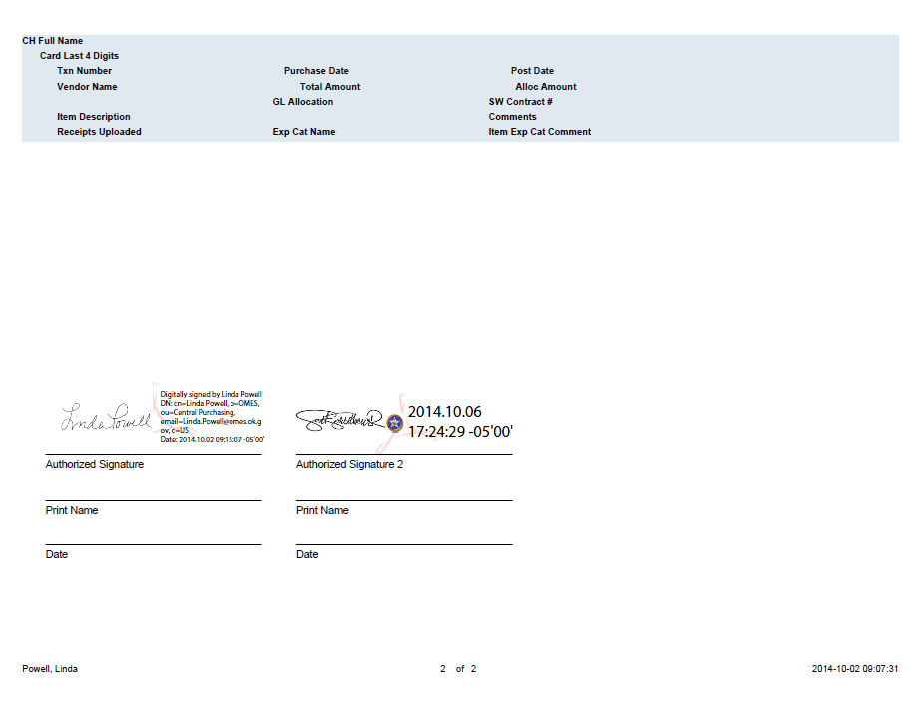
Statement signature page
Electronic signatures are acceptable, but must be an approved format. The signature here is an Adobe signature and has the time/date stamp and indicates the computer that was used to sign the document. A simple script signature without the authentication information is NOT considered an electronic signature and would NOT be acceptable.

Slide 94
So………where do I find
all this lovely
information????

Slide 95
www.omes.ok.gov

Slide 96
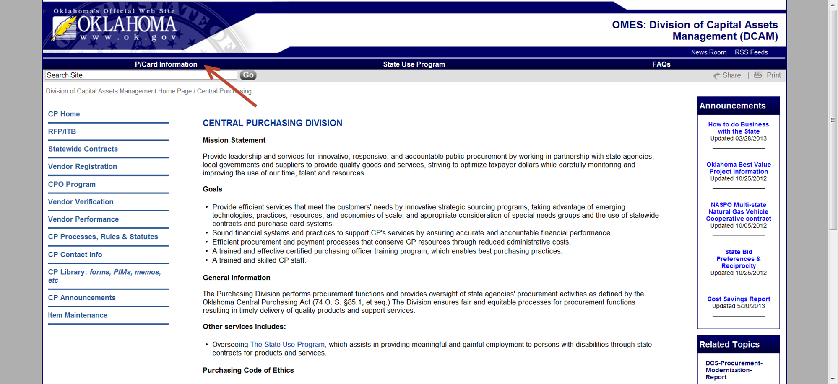

Slide 98
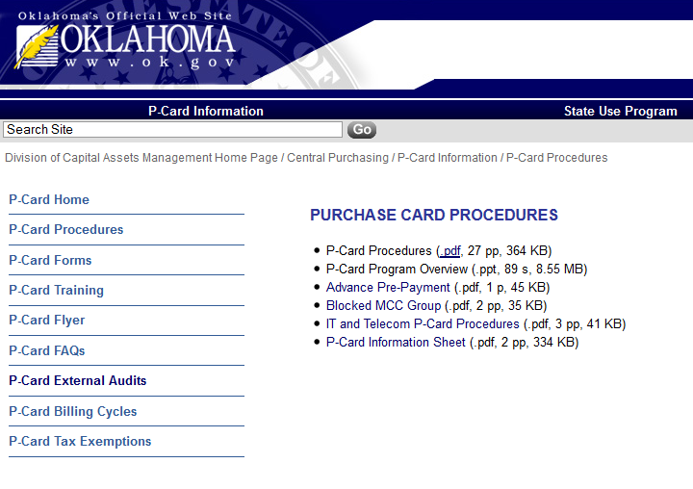
To access the P-Card Procedures, click on the underlined pdf. Clicking on the
P-Card Procedures will not do anything.

Slide 99
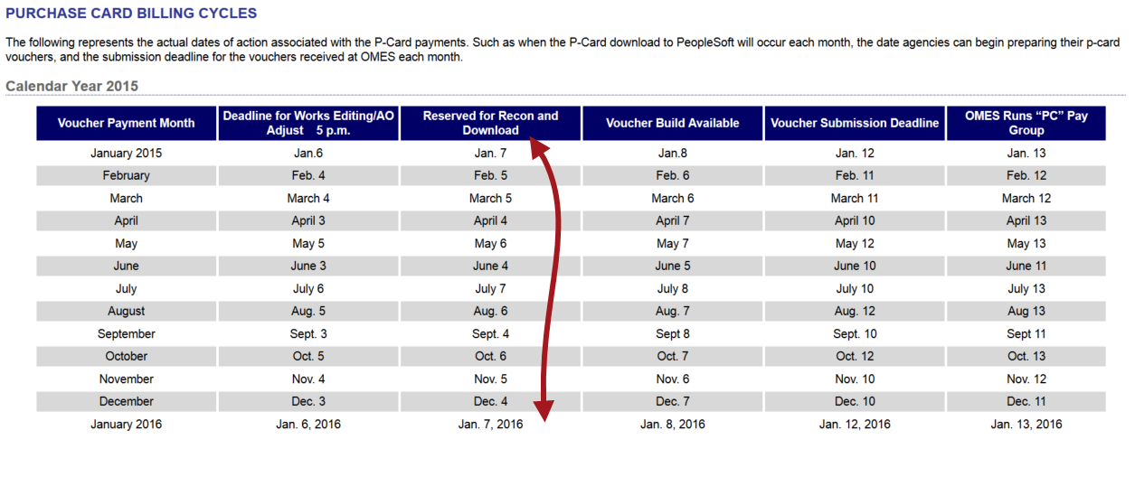
It is extremely important that ALL editing be completed PRIOR to the deadline date/time listed here.
Do NOT edit in Works or process a change order on the date next to the red arrow. Any changes made in Works will
not be transferred to People Soft. Changes to the AO will cause the load to fail from Works to People Soft.

Slide 101
State Travel Office Contact Information
STATE TRAVEL MANAGER TRAVEL PROGRAM ADMINISTRATOR
Richard Williams Linda Powell
(405) 522-4812 (405) 522-1654
richard.williams@omes.ok.gov linda.powell@omes.ok.gov
CENTRAL TRAVEL MAILBOX
agency.travel@omes.ok.gov

Slide 102
State Travel Website www.omes.ok.gov

Slide 103
http://www.ok.gov/DCS/Central_Purchasing/Agency_Travel

Slide 105
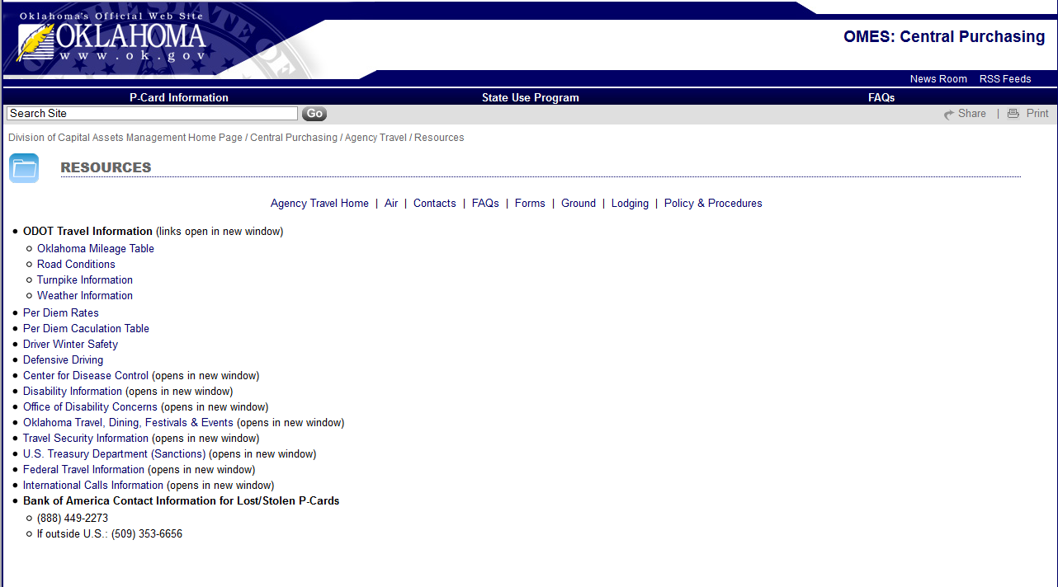

Slide 106
Contract
SW210 – FCm for travel agent services. This contract features an online booking tool (OBT) option for reduced booking fees. (discounted vacation packages are available through the travel club link found on the employee discounts page)
Most agencies have implemented SW210. Once your agency has been trained either by viewing the WebEx or the State Travel Office, SW210 becomes mandatory for your agency.
Contracted airfares for international flights and city pairs have been uploaded into Concur.

Slide 107
FCm Operations
Your designated FCm team
Hours: Monday - Friday
8:00am to 5:30pm CST
T: 855-763-9257
T: 713-300-1641
E: Oklahoma@us.fcm.travel
8 Greenway Plaza Suite 615 Houston TX 77046
Team Leader Alisia Coetzee
Team Members Chantalle Oyardo
Mari Soto
Afterhours Emergency Travel Center (ETC)
Calling from within USA: 855-763-9257
Calling from overseas: +1-847-597-6195
FCm Online Helpdesk Concur Helpdesk For technical assistance, please contact the Concur helpdesk
Hours: Monday - Friday
8:00am to 8:00pm ET
T: 888-308-3288
E: online@corp.fcm.travel
Concur
www.concursolutions.com

Slide 108
Traveler Profiles
Traveler profiles can be managed by the travel arranger
Once information is entered it is saved for future bookings
Agent team accesses traveler profiles to provide assistance
Assistance is available from the State Travel Office with entering new employees
Guests can be booked without setting up a profile
Notes:
Note: profiles should be updated at least 30 minutes prior to booking flights to allow the changes to route through the system. To pull the changes into the system, you will need to log off and then log back in so it’s a good idea to update all profiles of your travelers well in advance of needing to book flights.

Slide 109
Fees
Online booking tool (OBT) with NO agent assist $9
Agent assistance with booking flight $25
Agent assistance after 5:30 PM, weekends, holidays $20
Emergency after hours assistance $20
If booking is started through the OBT, and any required information is missing from the profile, an agent may complete the booking and then charge the difference of $16, bringing the cost up to an agent fee.
Calling an agent after 5:30 PM or before 8:00 AM will incur not only the $25 agent fee, but also the after-hours fee of $20.

Slide 110
State P-Card Team:
P-Card Administrator – Linda Powell, CPO
Linda.Powell@OMES.ok.gov
405-522-1654
Back-up P-card Administrator - Vickie Rivas, CPO
Vickie.Rivas@OMES.ok.gov
405-522-4970

